Slide 1
Brew-Crew Final Update

Slide 2
Contents of this presentation
Introduction to the team, how we work & the background to the project
How have we handled your data and what tools did we use?
Data visualisation, what does your data mean?
Team reflection

Slide 3
Introduction

Slide 4

The Brew-Crew
SM:FEMI
KATERINA
PRANS
RIO
FEMI
KATERINA
PRANS
SM: RIO

Slide 5
The Project & Infrastructure

Slide 6
The Issue…
Not able to collate end of day sales to one location
No evaluation
No comparisons between branches
Cannot identify emerging trends
Loss of revenue

Slide 7
The Solution…
Create a central location to collate data from all your branches
Daily automation
Use a data visualisation tool for analysis to find:
Emerging trends
Potential revenue streams
Expansion opportunities
Compare branch takings

Slide 8

The Processes
Weekly scrums
Plan out week
Daily standups
Delegate jobs
Estimate time needed
Regroup to update/discuss
README
Overview of project
Week by week progress
Contains documentation links
Project roles
Split based on strengths and areas we want to improve on

Slide 9
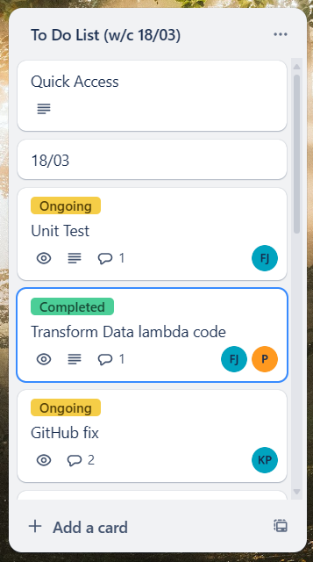
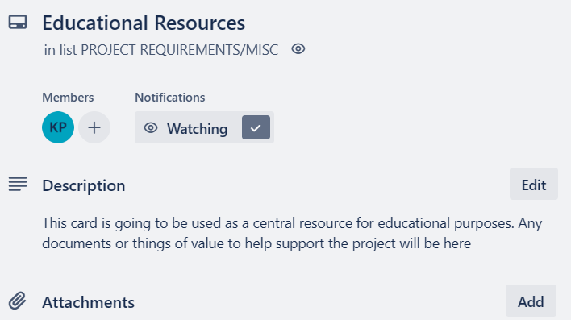
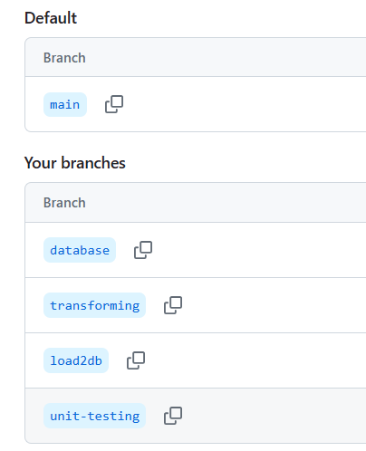
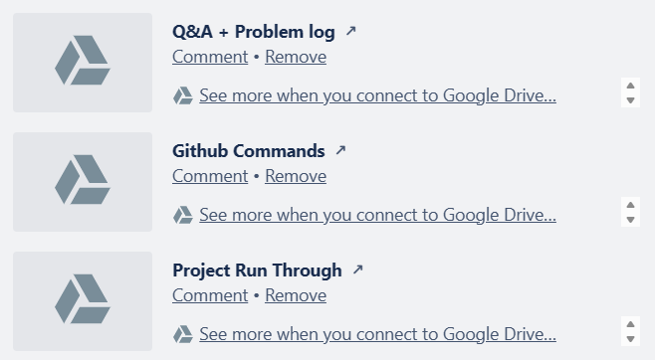
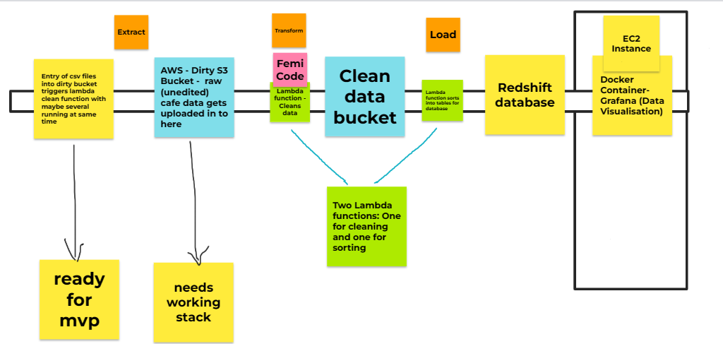
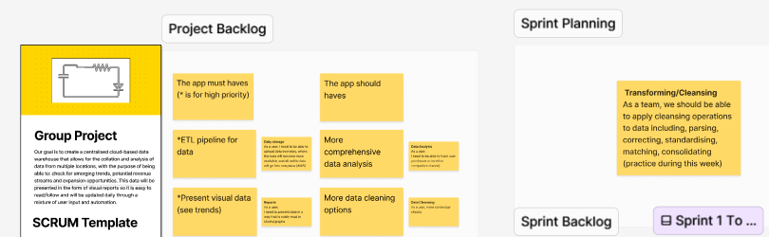
The Tools and Documentation
Trello
Educational Resources
GitHub
Jamboards
Figma

Slide 10
Infrastructure

Slide 11





Architecture
S3 Bucket:
Hold raw and clean data
Minimal amount to reduce cost
Lambda Function:
Transform data
Load data to data warehouse
IAm Role:
Access control
Interact internally and externally securely
CloudFormation (Infrastructure as Code):
Stack of components
Automates
Deploys all in a single command
Reliable and repeatable

Slide 12




Architecture
Docker Container:
Grafana runs within container
Portable and isolated environment for running Grafana
Avoids complexity
EC2 Instance:
Pulls data in from Redshift to Grafana
CloudWatch:
Monitor health and performance
Metrics
Debug
Amazon Redshift:
Data warehouse
Holds all data from all branches

Slide 13
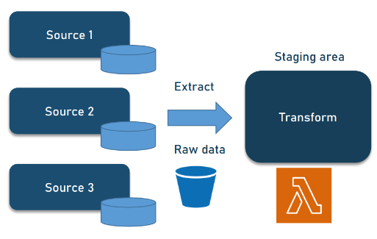
Extract & Transform stage

Slide 14
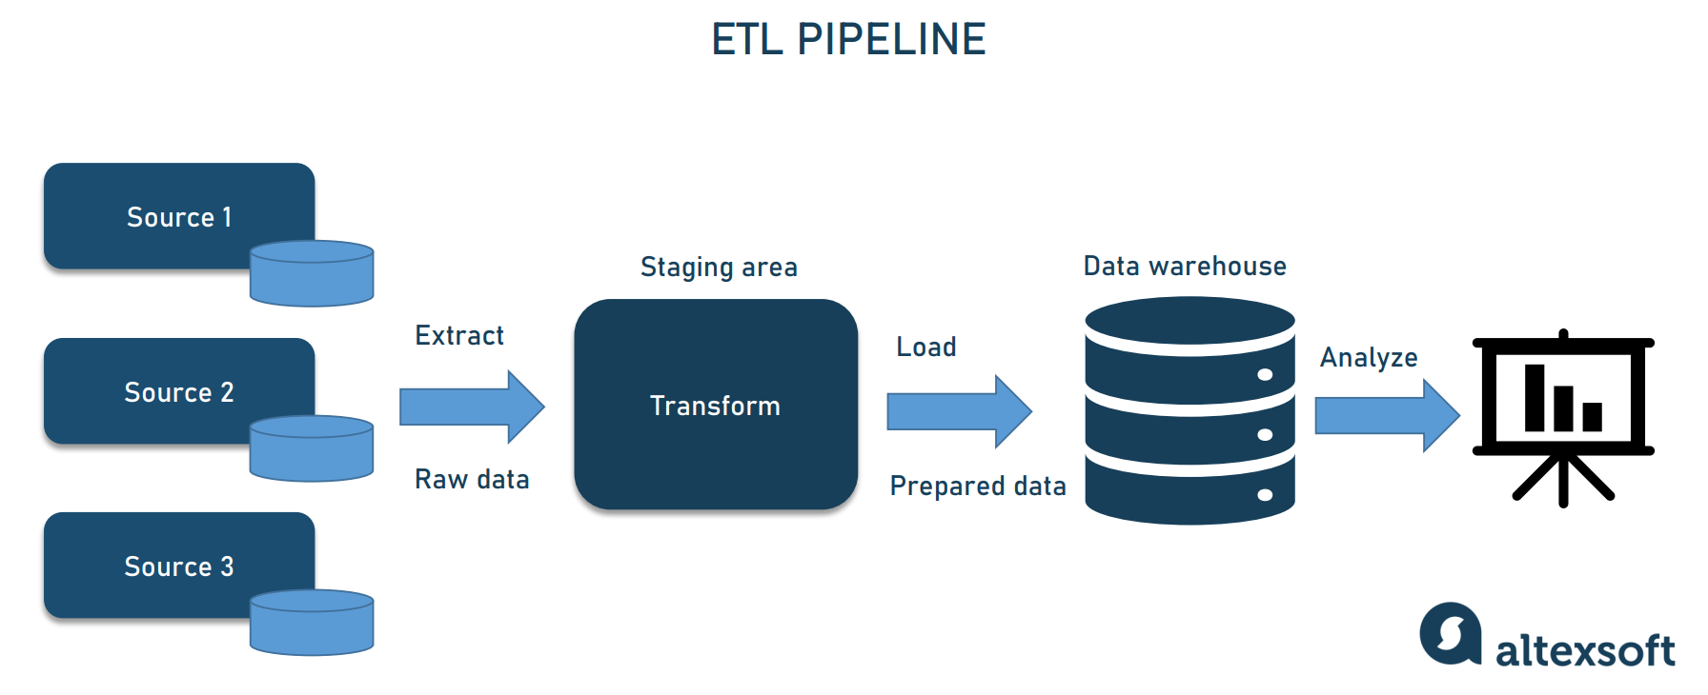

Explaining how we aim to transform the data (ETL PIPELINE)

Slide 15
S3 buckets
S3 bucket - a public cloud storage resource within AWS.
Designed to store objects.
Flat storage, unlike traditional hierarchy

Slide 16
Lambda Functions
User defined functions without a name-simple expressions
Serverless Execution - Managed by AWS, lets developers focus on writing code
Cost effective - you only pay for the compute we consume
Event driven - We can trigger Lambdas by events, such as object creation or set per timer

Slide 17

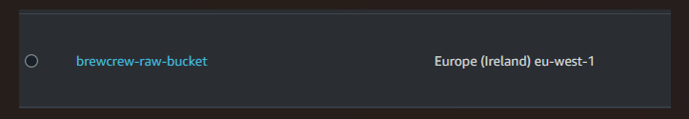
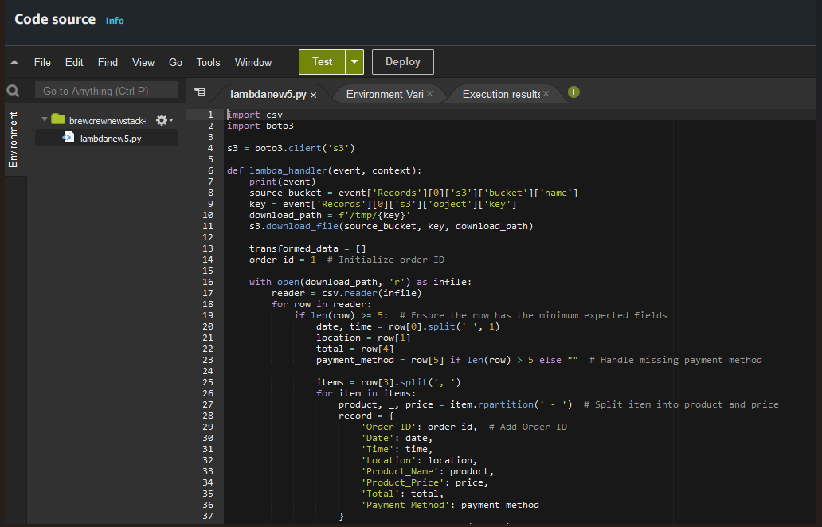

Trigger created on raw data bucket
Automated for 8pm every night, sales data is sent to bucket
Where your raw data is held
Lambda function is triggered
Contains transformation code
Pushes to clean bucket
Where your clean data is held

Slide 18


Additional Buckets
Deployment Bucket
Contains necessary resources ( zip files, templates, lambda functions)
Testing Bucket
Used to test code before deployed to pipeline
4 buckets in total for organisation
Minimal for low cost

Slide 19
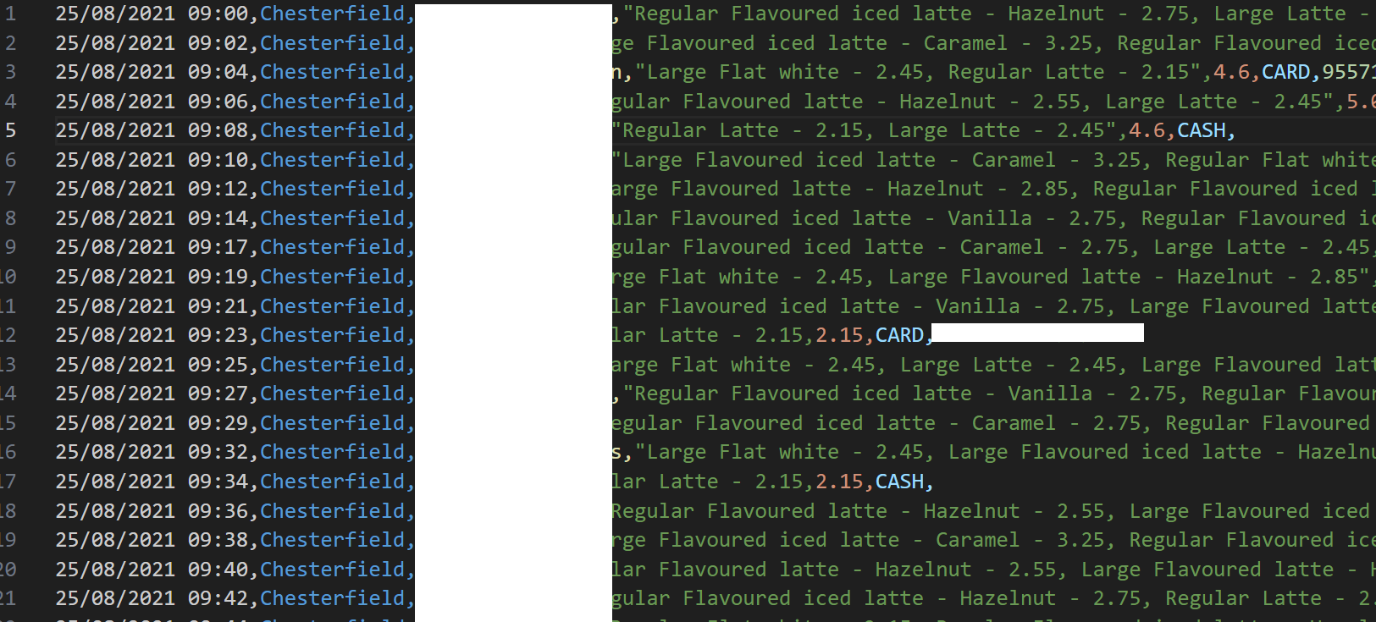
Before Data Cleansing
Raw data as we receive it from your company.

Slide 20
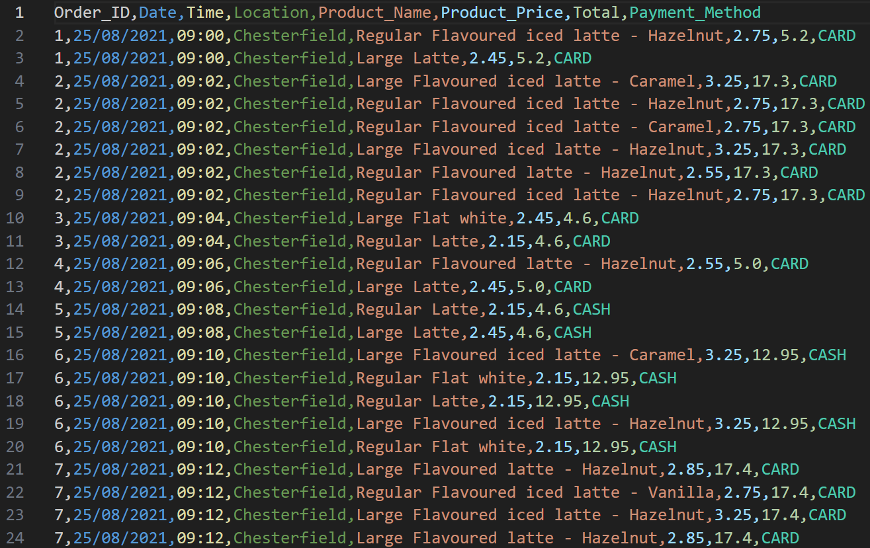
After Data Cleansing
Transformed data. Sent to clean bucket, to be loaded into data warehouse.

Slide 21
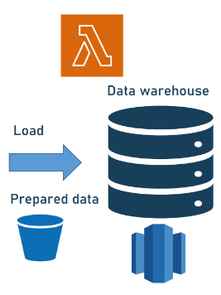
Load stage

Slide 22
Why Redshift as a Data warehouse?
Scalability
Helps us optimize performance
Very cost-effective
Integrates well with other AWS services, such as S3, EC2.
Security- IAM authentication and encryption

Slide 23
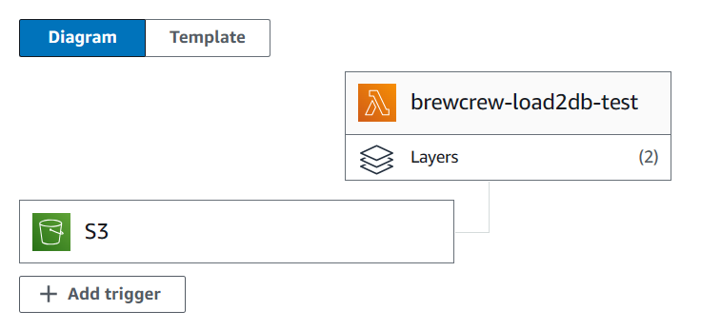
Loading process
After transforming…
Additional Lambda function to move data to data warehouse (Redshift)
Organises data into their correct table following database schema

Slide 24
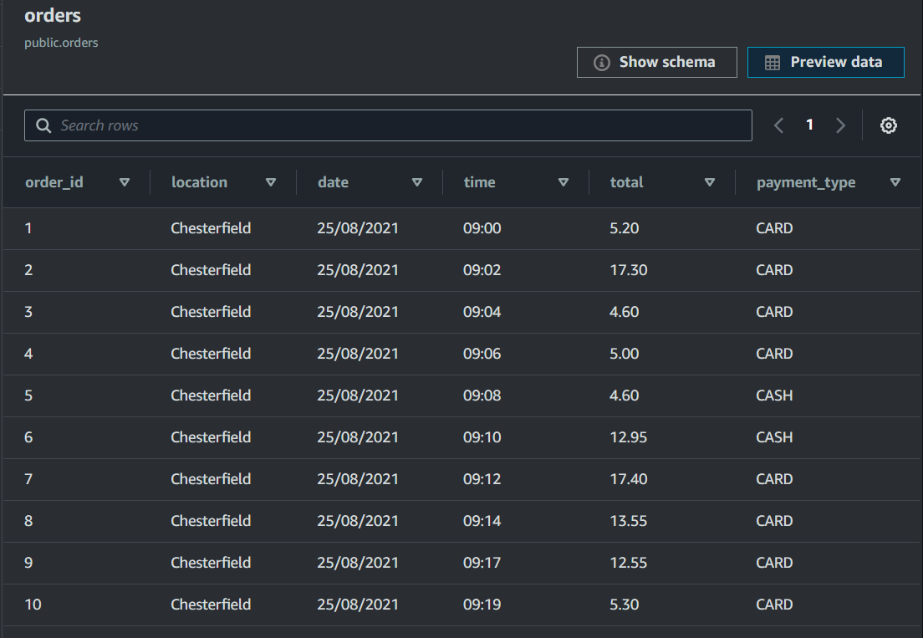
What the database looks like

Slide 25
Data Analysis stage

Slide 26
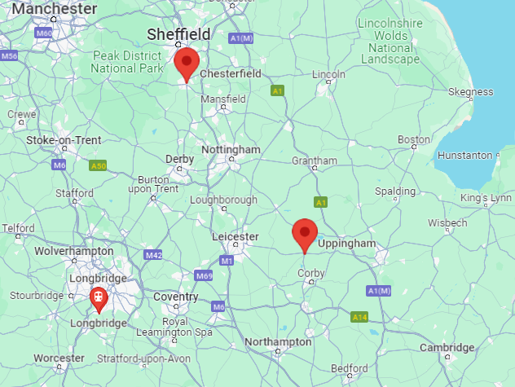
Key statistics from the data we received
Total sales info: £7,210
Location, location, location
Card payments are on the rise
Potential suggestions

Slide 27
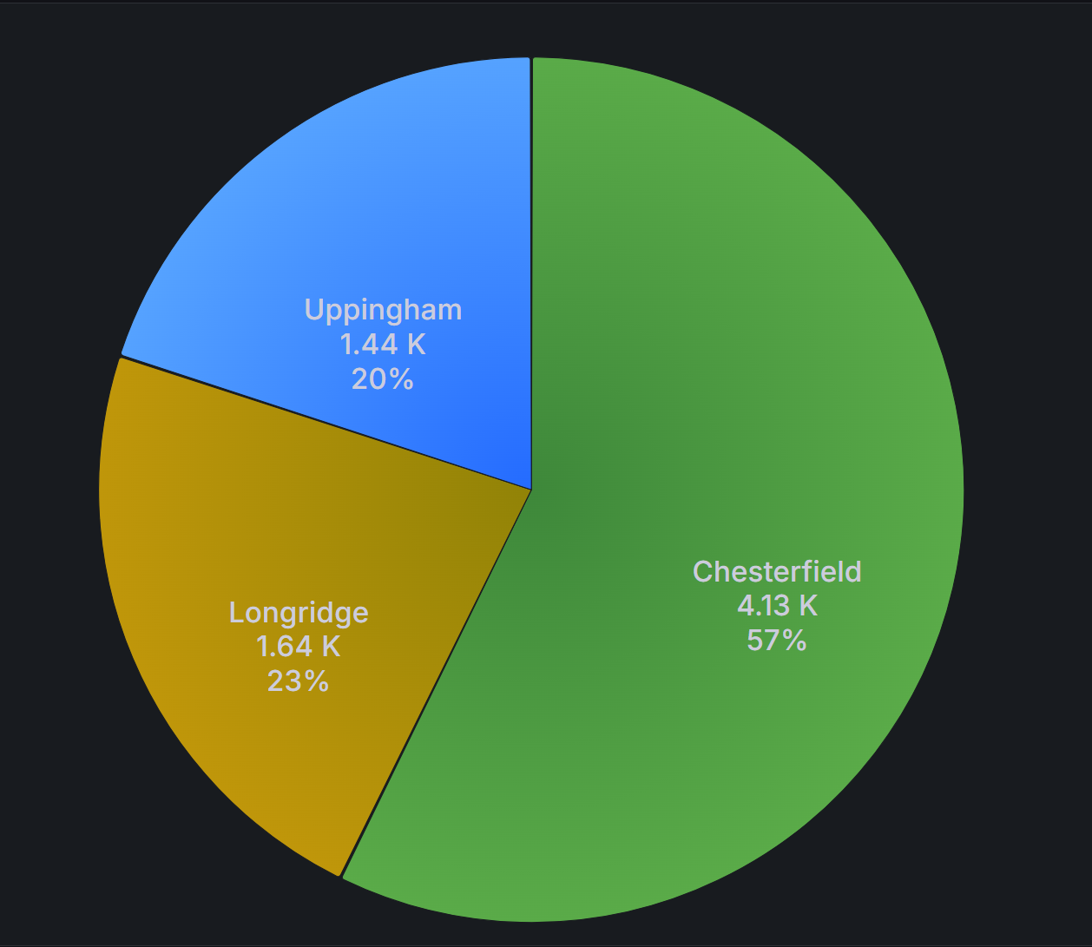
Store break down
So what can we see from looking at this data:
Based on the locations, we can see that Midlands is the hub for your company
Chesterfield is your highest grossing store, accounting for over 50% of your sales
Suggestions: Loyalty card scheme and Themed menus around events
Notes:
Population - Longridge (8,000ish)
Population - Uppingham (4,000ish)

Slide 28

Card vs Cash Payments
Based on this data, we see can that:
‘Card is King’ with a massive 72% of purchases being made through card payments
There is a huge shift from cash
Suggestions: Online purchases and Gift cards

Slide 29
Exciting next steps/updates
Here are some exciting updates that we are looking to introduce in the near future:
The ability to highlight the top grossing individual products
Track emerging trends based on sales
A deeper dive into the location stats

Slide 30
Team Reflection

Slide 31
Challenges that we faced
The initial transform stage
Database set up
Data visualistion tool
Notes:
The initial transform stage - The decision was made whether to drop rows or fill in with viable placeholder data on raw, unclean csv files. The advantage of using placeholder data would be gaining deeper insights. However it was decided to drop rows to attain MVP.
Database set up - We had multiple iterations of what we planned the database to look like in terms of the model and approach. With the task at hand being so vast and approachable, it made that setting up process tricky as we all had different ideas and thoughts about what it should and more importantly shouldn’t include.
Data Visualistion Tool - Due to our initial database set up, it made processing the data a bit tricky when it came to actually presenting the data in a way that was applicable for visual purposes. This the made the Grafana a lot more difficult to use as we had to adapt and shift things around, putting us slightly off track.

Slide 32



What went well
Teamwork
The project overall
Learning experience

Slide 33
Thank you for listening

